Slide 1
Capstone Project
Email Campaign Prediction
By Rishekh Dubey

Slide 2
Points for discussion
Loading the data
Cleaning the data
Exploratory data analysis
Train- Test Split analysis
Random Forest Classifier
Conclusion

Slide 3
Data Summary
Problem Statement
Most of the small to medium business owners are making effective use of Gmail-based Email marketing Strategies for offline targeting of converting their prospective customers into leads so that they stay with them in Business.
This dataset has email interactions with the customers over time and their location.

Slide 4
Business Goal
We are required to build a model to characterize the mail and track the mail that is ignored; read; acknowledged by the reader.
Dataset
We created a directorial path for the Email dataset, using the Pandas read function we read it. It has a shape (68353, 12) which means it has 68353-row labels and 12 features or column labels.

Slide 5
Data Cleaning
We can see that there are multiple data which doesn’t contain any value, the data which doesn’t contain any value is called null value. We also have outliers in our dataset.
As our dataset contain multiple null values so in order to replace the null values we have used fill na method so that we can get better result.

Slide 6
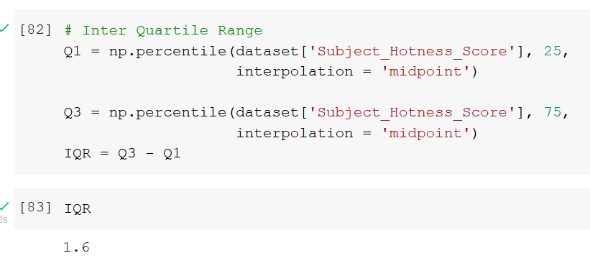
To remove outliers we have plotted the box plot to locate the outliers and then we have used IQR-based filtering (Inter Quartile Range) to remove the outliers from our data set.

Slide 7
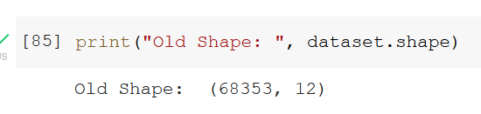
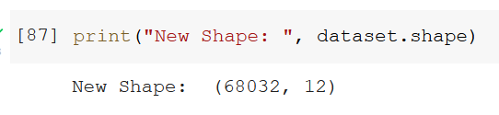
Shape of the dataset before IQR Filtering
Shape of the dataset after IQR Filtering

Slide 8
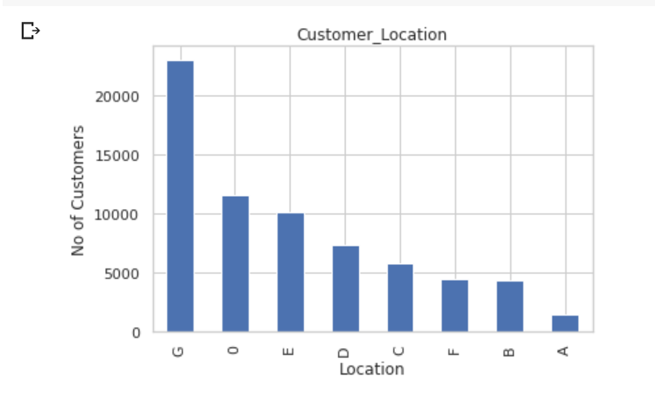
Customer’s Location
From the Bar plot, we can see that maximum customers are from "G" around 23173 and from "A" we have minimum customers around 1454.
We can see that the number of customers from “A”, “B”, and “F” are not more than 5000.

Slide 9
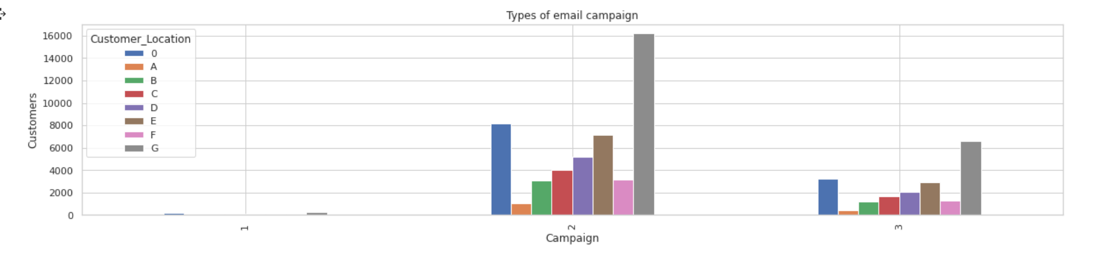
Email Campaign type for every location
We can see that most customers are getting emails from campaign number 2. Not a single customer is getting mail from campaign number 1.

Slide 10
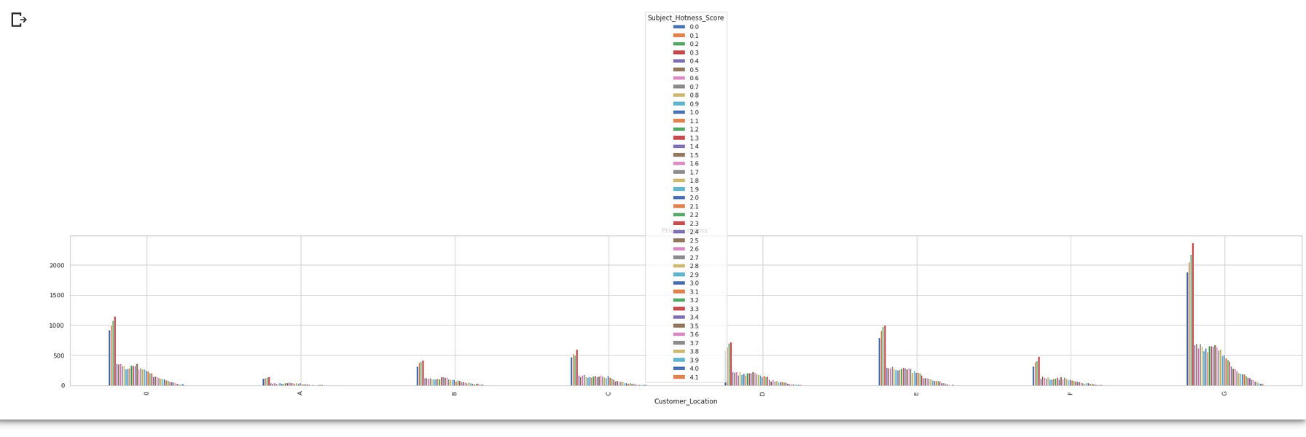
Email hotness score:-
By using the above bar plot we can see that the most number of hotness scores from every location is 0.3.
Hotness score from location “A” is the lowest whereas location “G” has the highest number of hotness scores.

Slide 11
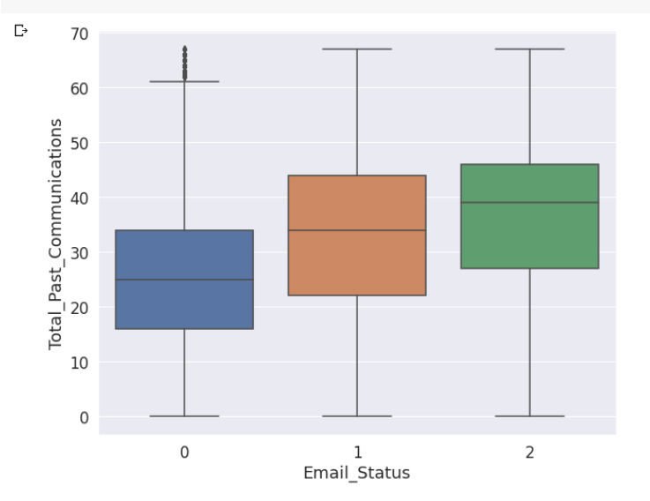
Email Status based on previous communication:-
This combination of box plots provides the variation of past communication with respect to the different types of email statuses.
This visualization shows that the mean of mail received from status 1 is around 35, mean
mail received of status 0 is around 25 and mean mail received of status 2 is around 39.

Slide 12
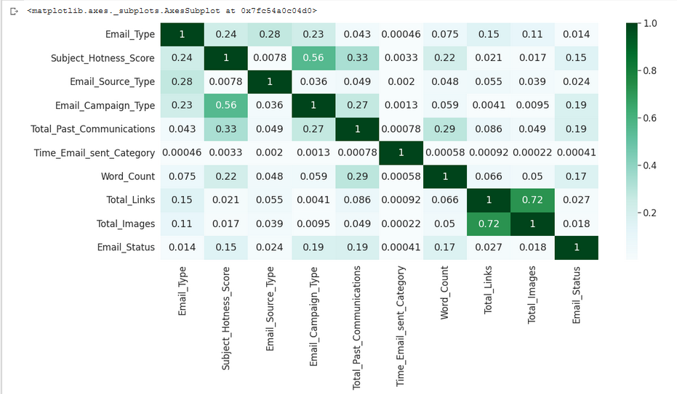
Correlation
This is a heatmap chart that represents the relation between one feature and another one.
By plotting seaborn heatmap correlation we got to know that there features positively correlated with each other.

Slide 13
A correlation value can be positive, negative, or neutral/zero. Where positive refers to that both the variables move in the same direction, negative shows that one variable’s value increases, the other variables’ values decrease. Neutral/zero means that variables are unrelated to each other.
By plotting seaborn heatmap correlation we got to know that their features positively correlated with each other, among which Total_links and Total_Images are highly correlated.

Slide 14
Standardization:-
We have standardized our dataset so that all the variables get equal importance it's like rescaling the values so that all the variable doesn’t greatly differ from each other.
We have used standardscaler, the idea behind StandardScaler is that it will transform your data such that its distribution will have a mean value of 0 and standard deviation of 1

Slide 15
Train and Test Analysis:-
The train-test split is used to estimate the performance of machine learning algorithms that are applicable for prediction-based Algorithms/Applications.
This method is a fast and easy procedure to perform such that we can compare our own machine learning model results to machine results.

Slide 16
In this analysis, we divide the dataset into two data subsets. The first subset is used to fit the model which is called the training dataset. Then the second subset is used for prediction as compared to expected values this is called the testing dataset.
We have used train data as 80% and test data as 20%. Scikit-learn alias sklearn is the most useful and robust library for machine learning in Python.

Slide 17
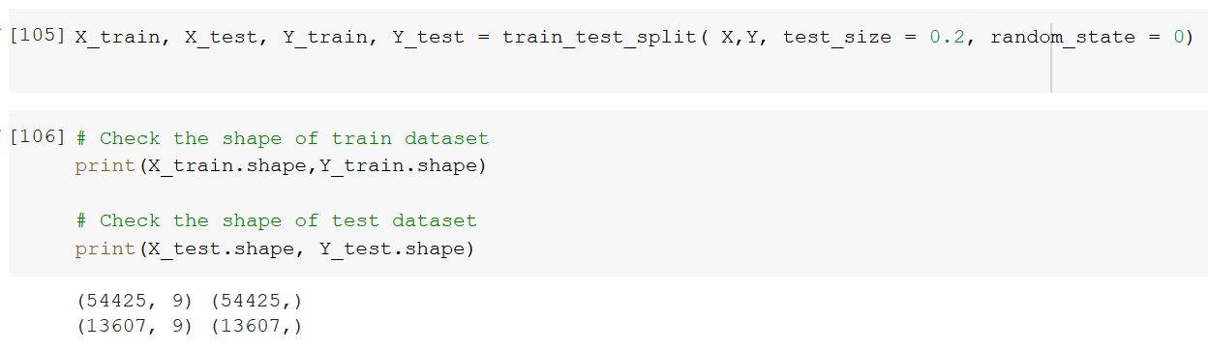
Here, X, is our independent variable and y is our dependent variable. Test size=0.2 specify that only 20% of the dataset is used for the test data set. The random state gives us the random split every time.

Slide 18

Random Forest Classifier:-
Random Forest is a classifier that contains a number of decision trees on various subsets of the given dataset and takes the average to improve the predictive accuracy of that dataset." Instead of relying on one decision tree, the random forest takes the prediction from each tree and based on the majority votes of predictions, and predicts the final output.
1) In Random Forest, we grow multiple trees as opposed to a single tree in CART model.
2) We construct trees from the subsets of the original dataset. These subsets can have a fraction of the columns as well as rows.
3) To classify a new object based on attributes, each tree gives a classification and we say that the tree “votes” for that class.

Slide 19
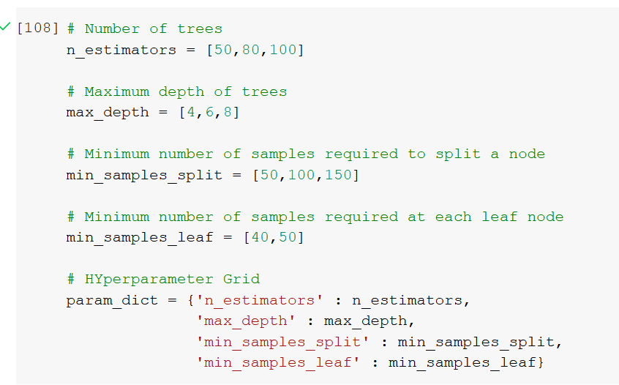
Hyper parameter tuning
Hyperparameter specifies the minimum number of samples that should be present in the leaf node after splitting a node.

Slide 20
N_estimators- It decides the number of trees.
Max_depth- The max_depth of a tree in Random Forest is defined as the longest path between the root node and the leaf node. Using the max_depth parameter, I can limit up to what depth I want every tree in my random forest to grow.
Min_samples_split- a parameter that tells the decision tree in a random forest the minimum required number of observations in any given node in order to split it.
Min_samples_leaf- This Random Forest hyperparameter specifies the minimum number of samples that should be present in the leaf node after splitting a node.

Slide 21
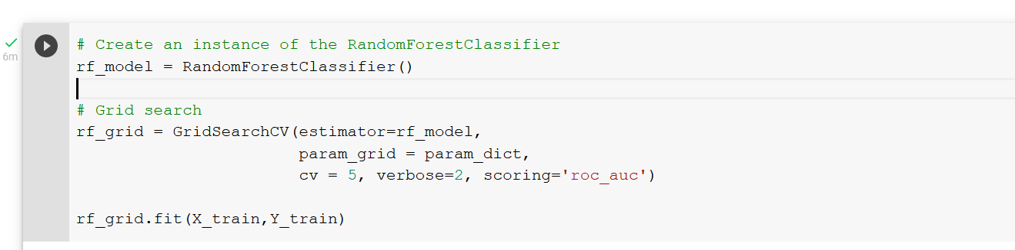
Grid Search CV:-
GridSearchCV tries all the combinations of the values passed in the dictionary and evaluates the model for each combination using the Cross-Validation method.
Hence after using this function we get accuracy/loss for every combination of hyperparameters and we can choose the one with the best performance.

Slide 22
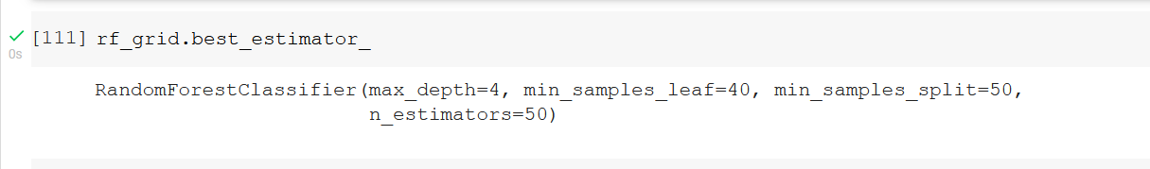
Best Estimator

Slide 23
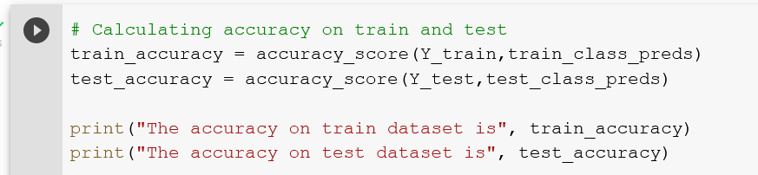
Accuracy check on Training and Test data:-
The accuracy of the training dataset is 0.8104180064308681
The accuracy of the test dataset is 0.8098772690526934

Slide 24
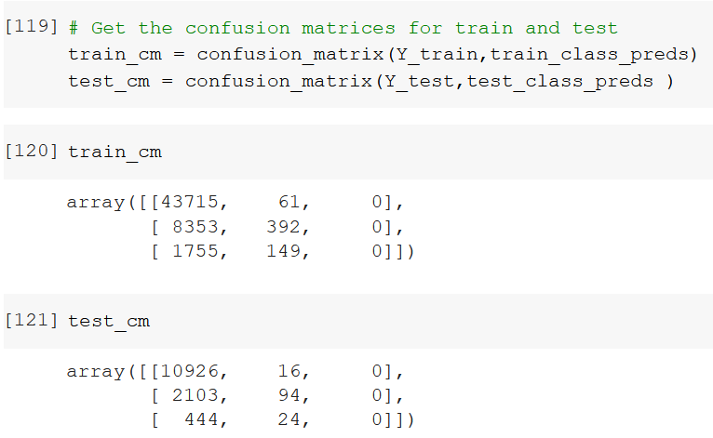
Confusion Matrix
A confusion matrix is a summary of prediction results on a classification problem.
The number of correct and incorrect predictions are summarized with count values and broken down by each class. This is the key to the confusion matrix
The confusion matrix shows the ways in which your classification model is confused when it makes predictions.

Slide 25
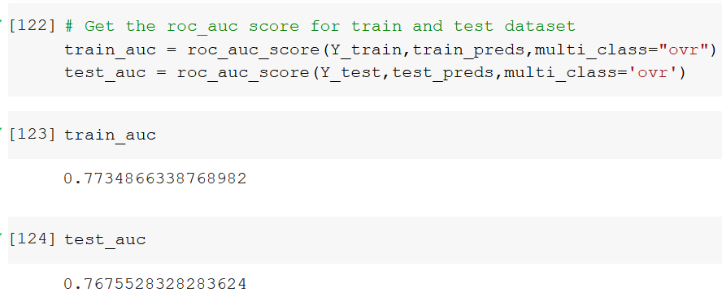
Roc_Auc Score

Slide 26
AUC provides an aggregate measure of performance across all possible classification thresholds. One way of interpreting AUC is as the probability that the model ranks a random positive example more highly than a random negative example.
AUC-ROC is the valued metric used for evaluating the performance in classification models. The AUC-ROC metric clearly helps determine and tell us about the capability of a model in distinguishing the classes.

Slide 27
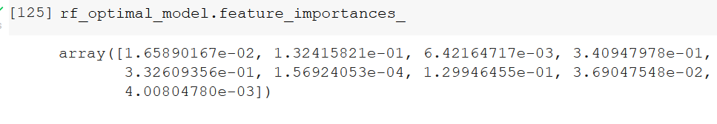
Feature Importance
It refers to techniques that assign a score to input features based on how useful they are at predicting a target variable.
Important features mean the features that are more closely related to the dependent variable and contribute more to the variation of the dependent variable.

Slide 28
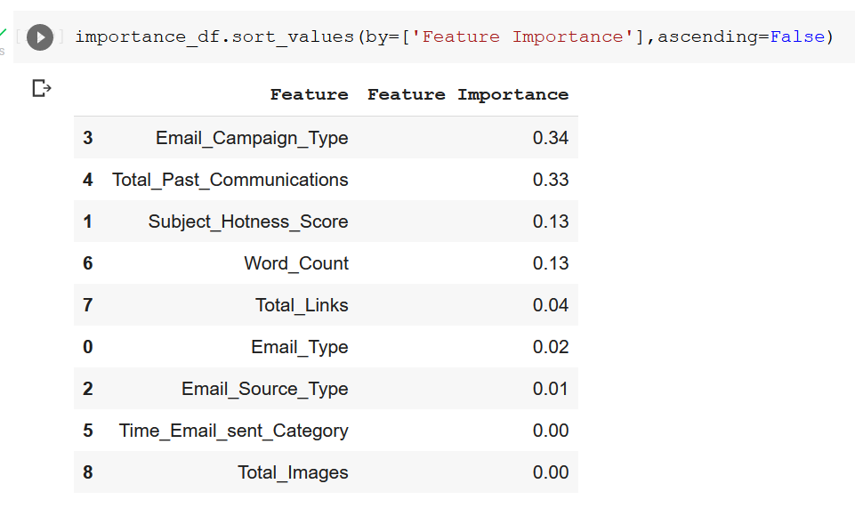
Feature Importance of all the variable

Slide 29
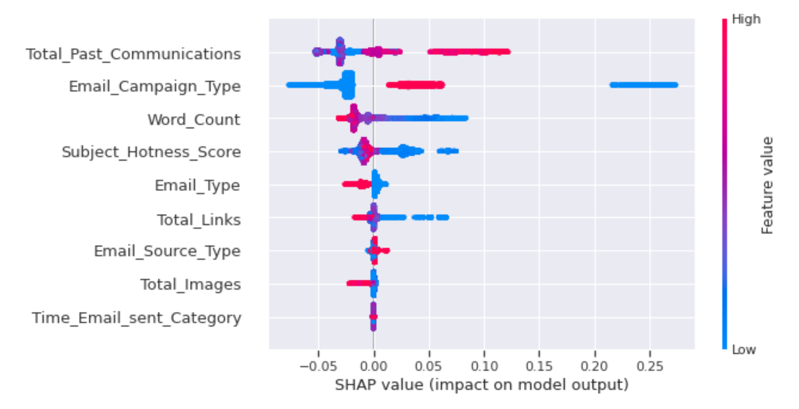
SHAP
SHAP values interpret the impact of having a certain value for a given feature in comparison to the prediction we'd make if that feature took some baseline value.

Slide 30
Conclusion:-
From the plot, we can see that the negative value of shap shows the Emails that have been ignored.
The positive value of shap shows the variable which is responsible for reading and acknowledging the Email.
AUC value for training data- 0.7708421124964002
AUC value for test data- 0.7646248070389722
As we know higher the AUC, the better the model. It proves that our model is predicting values efficiently.

Slide 31
References
Geeks for Geeks
Analytics Vidhya
towardsdatascience.com
machinelearningmastery.com

Slide 32
Thank You !!

